Slide 1
Social Media Sentiment Analysis using LSTM
EECE571T Project Presentation
Group 18
Vicky Zhao 94818283
Zhaohang Yan 56546559

Slide 2
Goal
Motivation: Investigate the potential of ML for social media sentiment extraction and analysis
Goal: Extract insights about public opinion from social media
Notes:
In recent years, the use of sentiment analysis has rapidly grown and become an important tool for organizations, governments, and individuals.
We propose the research to investigate the potential of machine learning for social media sentiment extraction and analysis. The goal is to develop models that can accurately and efficiently analyze social media data to extract insights about public opinion.

Slide 3
Strategy
Data Collection & Pre-processing
e.g., Sentiment140 dataset with 1.6 million tweets
Text representation
e.g., feature extraction, word embedding
Model training & evaluation
Notes:
There are three main strategies we use in this sentiment analysis.
First, we need to decide how to collect our train data. Here we want to use existing dataset.
Second, we need to choose text representation techniques to numerically represent the unstructured text documents to make them mathematically computable.
Third, we need to decide how to train and evaluate the model.

Slide 4
What worked
Dataset: Large Yelp Review Dataset¹, a dataset for binary sentiment classification. 560,000 highly polar yelp reviews for training, and 38,000 for testing.
Word Embedding: capturing context of a word in a document, semantic and syntactic similarity, relation with other words, etc. We used pre-trained Twitter GloVe Embedding from Stanford AI²
Model training: Sequence model with Long Short Term Memory (LSTM) model. More details in the Architecture section later.
Model evaluation: Confusion matrix
1. https://huggingface.co/datasets/yelp_polarity
2. https://nlp.stanford.edu/projects/glove/
Notes:
In our project,
We choose to use Large Yelp Review Dataset,
For word embedding, we used pre-trained Twitter GloVe Embedding package from Stanford AI.
For the training part, we use sequence model with LSTM (Long Short Term Memory).
For the evaluation part, we use Confusion matrix to show the performance of our classification model.
which is a dataset for binary sentiment classification, and there are 560,000 (five hundred and sixty thousand) highly polar yelp reviews for training, and 38,000 for testing.
We also use Word Embedding in our project, which is one of the popular representation of document vocabulary. It is capable of capturing context of a word in a document, semantic and syntactic similarity, and relation with other words. And we used pre-trained Twitter GloVe Embedding package from Stanford AI.

Slide 5
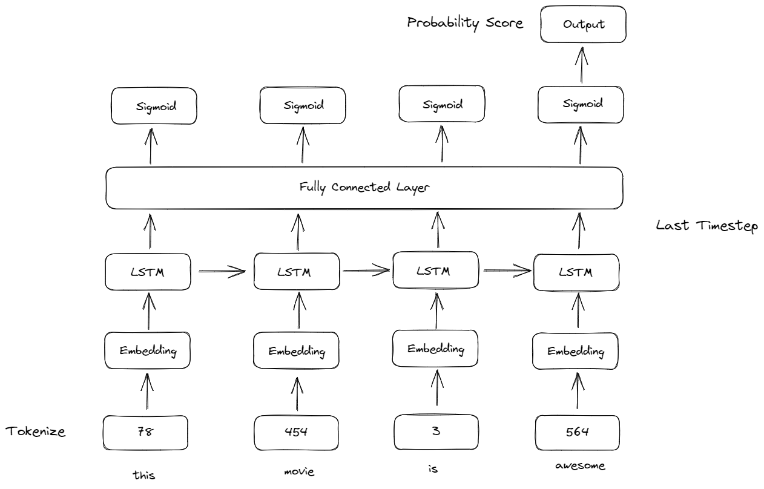
Architecture (Sequence Model)
Embedding Layer - Generates Embedding Vector for each input sequence.
Conv1D Layer - Its using to convolve data into smaller feature vectors.
LSTM - Long Short Term Memory
Dense - Fully Connected Layers for classification
Notes:
In our project we choose to use Sequence Model, because some words (for example, the word “the”) are predominantly feature in both Positive and Negative yelp reviews. This could be a problem if we are using a Machine Learning model like Naive Bayes or SVD.
And there are four kinds of layers in our model:
First is Embedding Layer, and it generates Embedding Vector for each input sequence.
Second is Convolution 1D Layer, we use this to convolve data into smaller feature vectors.
Third is Long Short Term Memory(LSTM), and which is a variant of RNN, and it has memory state cell to learn the context of the words which are at further along the text to carry contextual meaning rather than just neighbouring words.
Last we use Dense, which are fully Connected Layers for classification.
(This layer helps in changing the dimensionality of the output from the preceding layer so that the model can easily define the relationship between the values of the data in which the model is working.)
Reccurent Neural Networks can handle a sequence of data and learn a pattern of input sequence to give either sequence or scalar value as output. In our case, the Neural Network outputs a scalar value prediction.

Slide 6
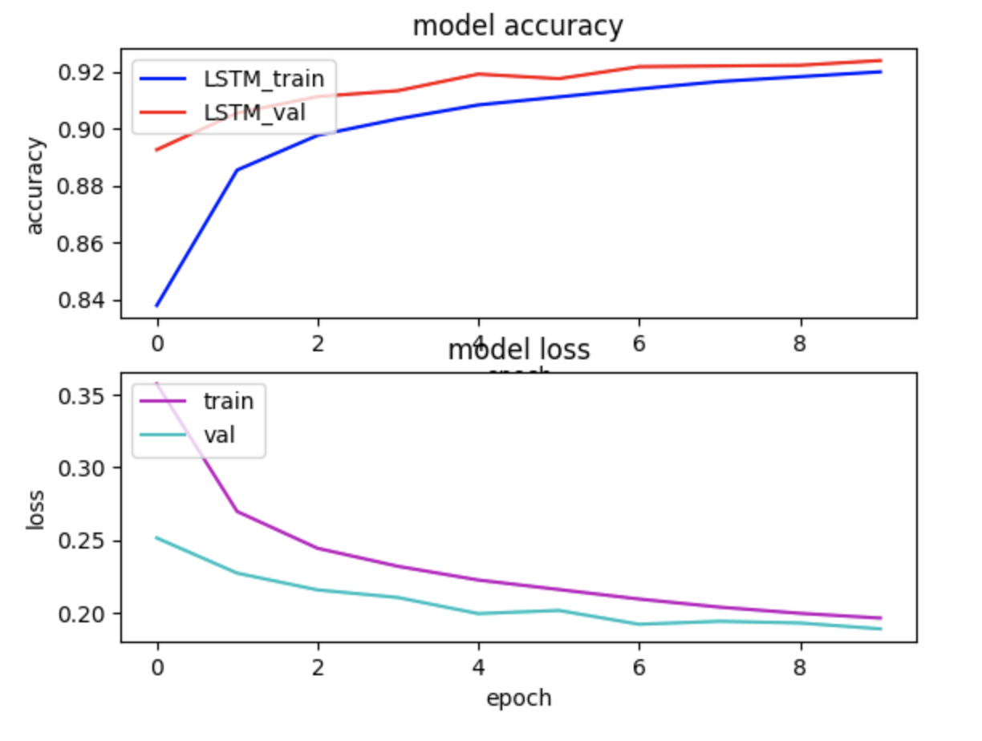
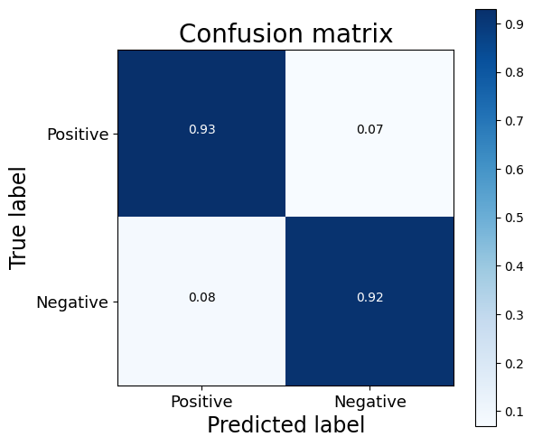
Results (Model evaluation)
Notes:
Result shows that the model will output a prediction score between 0 and 1, and we can classify two classes by defining a threshold value which we set as 0.5. If the score is above 0.5, it will be classified as POSITIVE sentiment.
From the left graph, we can see that the train accuracy is around 0.93, and train loss is around 0.20.
From the right confusion matrix, we can see that the true positive or negative value is around 0.92, and the true negative value is 0.92

Slide 7
What did not work
Dataset
❌ Sentiment140 dataset with 1.6 million tweets (collected around 2009)
✅ Large Yelp Review Dataset (collected around 2015)
Text representation
❌ Feature extraction
✅ Word embedding
Example:
Feature extraction may struggle to some sarcastic or ironic statements
"Great, just what I needed. Another meeting to attend. #not"
Notes:
During the implementation, we have encountered several problems and have to choose alternatives in some of the strategies.
In terms of text representation, both feature extraction and word embedding are techniques for representing text data in a machine-readable format.
Feature extraction involves the manual engineering of features based on some domain knowledge to capture important information about the text data. In contrast, word embedding involves learning a feature representation from the data itself, which captures the semantic relationships between words.
In social media, traditional feature extraction may struggle to accurately capture sentiment in ironic statements.
For example, the tweet "Great, just what I needed. Another meeting to attend. #not" may be seen as positive due to the words "great" and "attend," but the hashtag not indicates negative sentiment.
Word embeddings can capture semantic meaning and context, allowing for a more nuanced sentiment analysis that accounts for irony.
In terms of dataset selection, we wanted to use classic sentiment140 dataset with 1.6 million tweets but it’s too old since it was collected around 2009. Therefore, we finally used the Large Yelp review dataset which was collecte around 2015.
(Both techniques aim to transform text data into a structured, machine-readable format that can be used as input to machine learning models. The specific technique used depends on the task and the nature of the text data.)

Slide 8
What did not work
Pre-trained word vectors (GloVe Global vectors for word representation)
❌ glove.6B.zip - Wikipedia 2014 + Gigaword 5 (6B tokens, 400K vocab, uncased, 50d, 100d, 200d, & 300d vectors, 822 MB download)
✅ glove.twitter.27B.zip - Twitter (2B tweets, 27B tokens, 1.2M vocab, uncased, 25d, 50d, 100d, & 200d vectors, 1.42 GB download)
Notes:
We also changed our pre-trained word embedding vectors to glove.twitter which was trained using data from Twitter. It fits our project since we’re studying social media sentiments.

Slide 9
Summary
Social Media Sentiment Analysis
Only classified into two general sentiments (Positive, Negative)
Future work: More sentiments type including Positive, Neutral, Negative, Happy, Sad, Angry, etc.
Automated Response
Social Media Sentiment Analysis can be used for different consumer centered industries to analyse people's opinion on a particular product or subject on Social Media.
Deploying automated bot on social media to rapidly respond to specific public sentiments when they are detected.
Notes:
In summary, our project has completed social media sentiment analysis for two general sentiments (positive and negative).
So in our future work, we can add classification for more sentiments like neutral, happy, angry, etc.
For some organizations or companies interest, we can also working on building automated bots on social media to respond to public sentiments towards a topic. For example, the bot can respond to sentiments in crypto market and sell/buy cryptos accordingly.

